Slide 1
A Study of Typhoon Analysis using Wind Data of GK2A Satellite
ESCAP/WMO TYPHOON COMMITTEE 18th Integrated Workshop/4th TRCG FORUM(23.11.27~12.1/Bangkok , Thailand)
Jinho Shin¹, Hyun-Kyoung Lee¹, Inchul Shin¹, Ji-Hoon Jung¹, Hee-Ae Kim³, Jun Dong Park², Jung-Hoon Sohn¹
1.National Meteorological Satellite Center, Korea Meteorological Administration (KMA),
2. National Aeronautics and Space Administration (NASA),
3. Seoul National University (SNU)

Slide 2
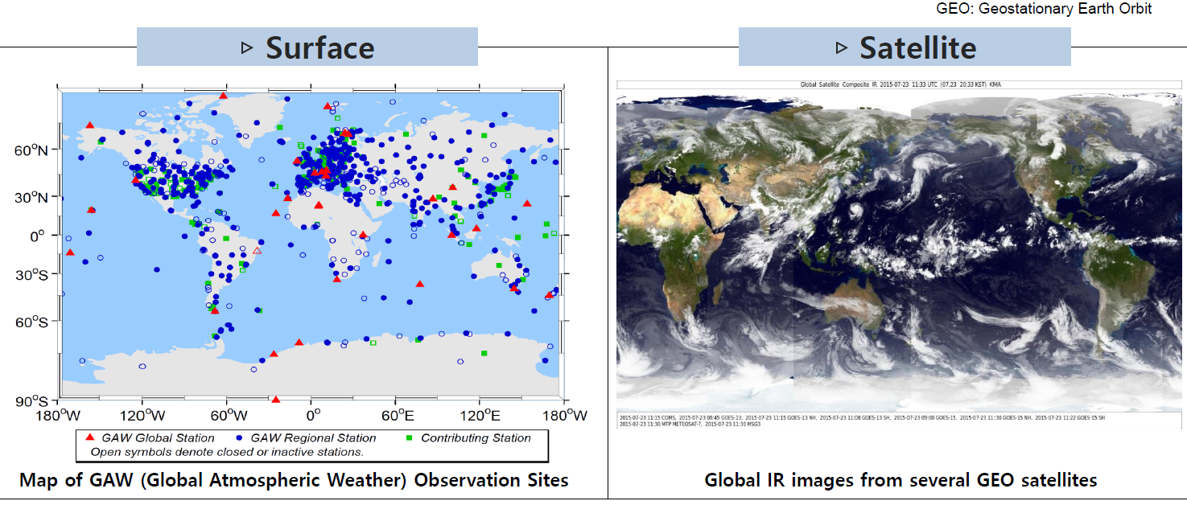
Why we need satellite observation?
Surface instruments are convenient to set up and operate, but they have difficulty in observing weather condition over ocean or upper atmosphere.
Satellites can provide information on ocean or the upper atmosphere for 24 hours with high resolution.

Slide 3
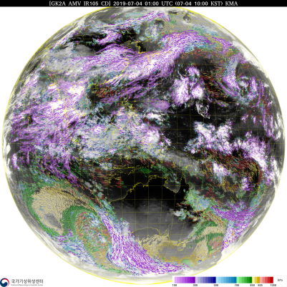
Why to estimate sea surface winds from satellites?
Why to use sea surface winds from satellites
Sea surface wind(SSW)s from scatterometer of low earth orbit(LEO) satellites are very useful for analyzing low-level winds in oceans and typhoon wind radii(>15m/s). But hey are limited to data utilization because of observation with 6 times per day(100-min orbits).
Since geostationary satellites can give atmospheric motion vector(AMV)s in every 30 minutes, try to estimate SSWs around a typhoon affecting the Korean peninsula using high temporal resolution of low-level AMV data of Geo-Kompsat 2A(GK2A).
Low Earth Orbit(LEO) satellite’s sea surface wind
GK2A’s 16 channels observations
in every 10 min and full disk area
GK2A AMV in every 30 min and full disk area

Slide 4
Data used to estimate and validate SSWs
Typhoon center location by ADT
GK2A’s Atmospheric Motion Vector(AMV)
ADT(Advanced Dvorak Technique)
- Variable : Typhoon center location with latitude and longitude and in every 10 minutes if a typhoon occurs.
Atmospheric Motion Vector(AMV)
- Calculated based on the movement of clouds or water vapour observed from GK2A
input channel | Visible(0.63um), Shortwave infra red (3.8um), Infrared (10.5um) : 3 channels
Wind speed | 0 to 100m/s
Wind direction | 0 to 360°
Altitude | 100~1000 hPa
Region | East Asia (3800 X 2400 km )
Temoral resolution | 10 minutes
Spatial resolution | Visible :12 km x 12 km / Infrared: 16 km x 16 km
LEO’s sea surface wind(SSW)
Sea Surface Wind(SSW)
- Retrieved from MetOp/ASCAT (Advanced SCATterometer) at 10-m altitude
- Spatial resolutions : 25 km, 12.5 km
Marine buoy’s SSW
BUOY from Korea Hydrographic and Oceanographic Agency (KHOA)
- Observed SSW at open oceans and closed to coasts
※ Data period : Summer 2019-2021 (July- September )
For verification

Slide 5
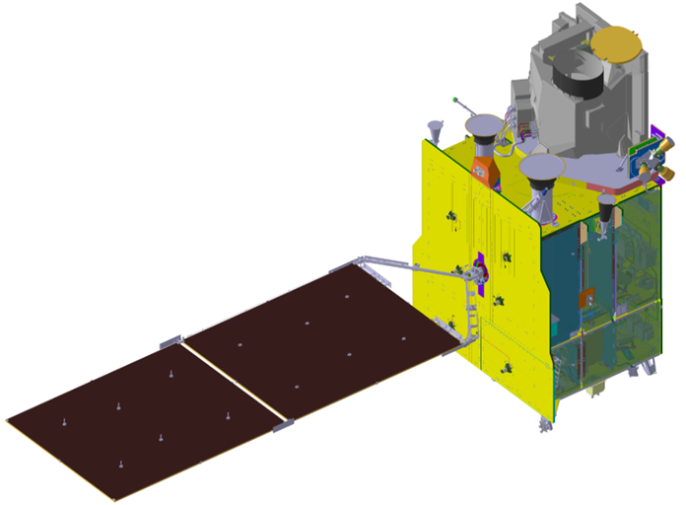
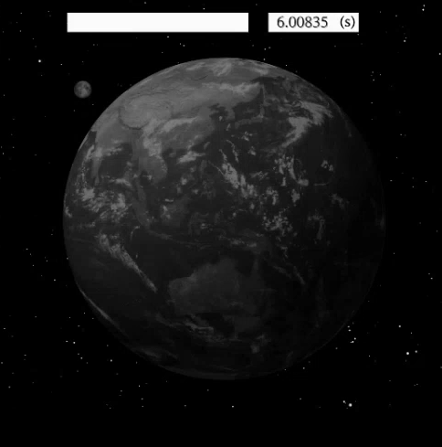
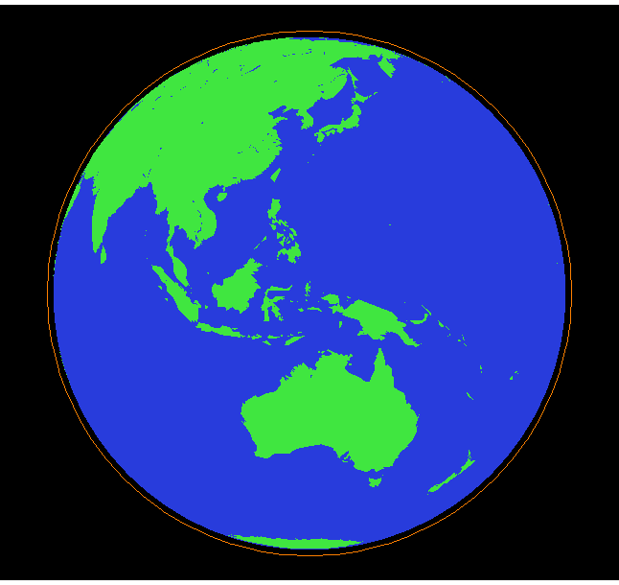
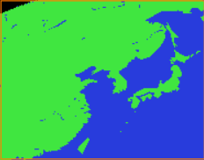
Input Data: GK2A observation
Observation area and frequency of GK2A
Full Disk : 1 time in every 10 min
Extended Local Area(ELA) : 3800 X 2400 km, 5 times in every 10 min
LA : 1000 X 1000 km, 5 times in every 10 min
GK2A
10 min.
Timeline
Full Disk
In every 10 min.
ELA
2 min
LA
2 min

Slide 6
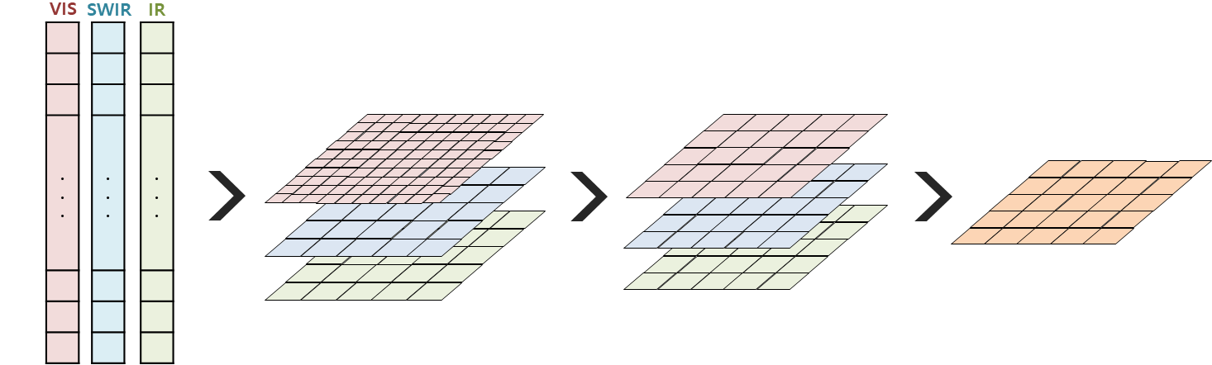
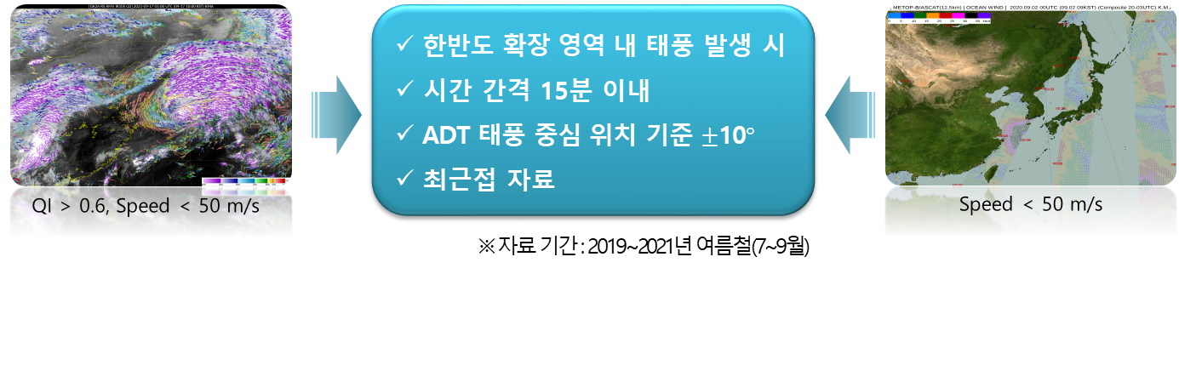
Processing to estimate GK2A SSWs
Selecting AMVs of VIS, SWIR, IR in 700~1000hPa
Making 2-D arrays with 0.5x0.5km for VIS & 2x2km for SWIR & IR
Converting spatial resolution from 0.5km to 2km for VIS
Calculating mean GK2A AMV with 2x2km
Calculating meam GK2A AMV
How to select GK2A SSW from mean GK2A AMV data
Only when a typhoon exits in the extended LA(ELA)
Two data of mean GK2A AMV and ASCAT SSW are less than 15 min
Area of ±10 degree from ADT typhoon center
Finally, extracting data from mean GK2A AMV nearest ASCAT SSW
Spatio-temporal
matching btwn mean GK2A AMV &
ASCAT SSW

Slide 7
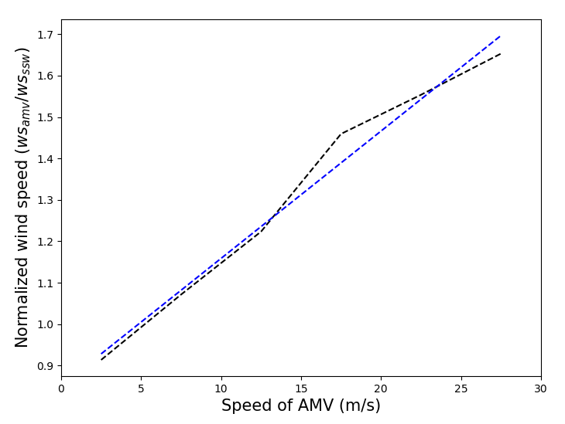
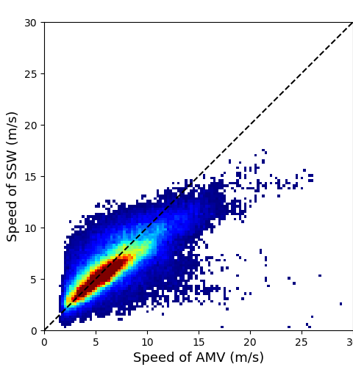
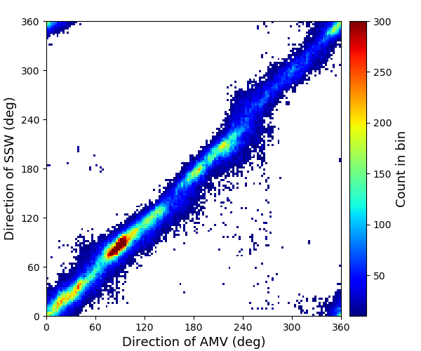

Method used to estimate GK2A SSWs
Regression
In previous studies of Nonaka et al(2016), wind speed(WS) of Himawari AMV is highly correlated (0.75~0.84) with that of ASCAT SSW:
$$WS_{ASCAT} =0.76× WS_{AMV}$$
This study applied normalized wind speed btwn AMV and ASCAT because the greater the difference of speeds between GK2A AMV and ASCAT SSW as the the wind speed becomes stronger.
Comparison between Himawari-8 AMVs and ASCAT SSW within a radius of 1,000 km from the center of TCs from May to December 2015(left: wind speed; right : wind direction) (Nonaka et al. 2016)
The correlation relationship using GK2A AMV and ASCAT wind in this study:
$$WS_{ASCAT}=WS_{AMV} / (0.03×WS_{AMV}+0.86)$$
Comparison between GK2A AMVs and ASCAT SSWs from July to September 2020~2021(left: wind speed; right : wind direction)

Slide 8
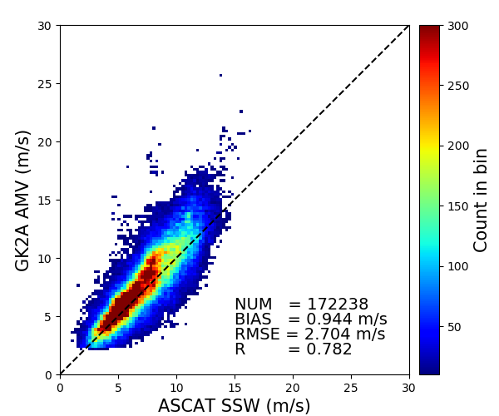
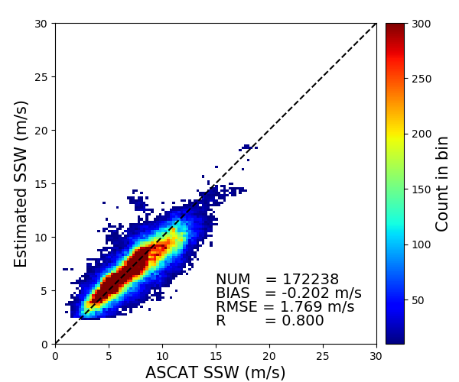
Verification of results
GK2A AMV vs ASCAT
Algorithm verification result(2)
(a)
Verification using ASCAT SSWs
Verification Period : Typhoon Cases from August to September 2019
Verification results for QI > 0.80
(a) GK2A AMV vs ASCAT (b) GK2A SSW vs ASCAT
Bias : 0.94 m/s → -0.20 m/s
RMSE : 2.70 m/s → 1.77 m/s
GK2A SSW vs ASCAT
In summary, a distribution of GK2A SSW is more similar to that of ASCAT SSW than GK2A AMV with a little bias and RMSE.
(b)
※ QI (Quality Index)
: Data quality evaluation based on homogeneity of time and space of vectors and similarity of numerical model winds
: With the range of 0 ~1, the closer to 1, the better quality the
vector.

Slide 9

Verification of results
Algorithm verification result(2)
Verification data : ASCAT SSWs
Verification Period : Typhoon Cases from August to September 2019
Executing verification GK2A AMV vs ASCAT SSW, GK2A SSW vs ASCAT SSW in each class of wind speed
In this study, found that wind speed difference between GK2A and ASCAT SSW for winds with stronger than 15 m/s are decreased largely compared to that of GK2A AMV and ASCAT SSW.
Wind speed (m/s) | Num. | GK2A AMV vs ASCAT SSW |  | GK2A SSW vs ASCAT SSW
 |  | Bias | RMSE | Bias | RMSE
0 ~ 5 | 23542 | -0.41 | 1.53 | -0.34 | 1.51
5 ~10 | 84506 | 0.75 | 1.87 | 0.11 | 1.63
10 ~ 15 | 53615 | 2.70 | 3.37 | 0.45 | 1.98
15 ~ 20 | 20178 | 5.14 | 5.68 | 0.61 | 2.27
20 ~ 25 | 2977 | 8.27 | 8.70 | 1.04 | 2.84
25 ~ 30 | 225 | 10.74 | 10.91 | 0.24 | 1.74
☞ For strong tropical cyclones (> 15 m/s), GK2A SSW data is more useful to analyze storms.

Slide 10
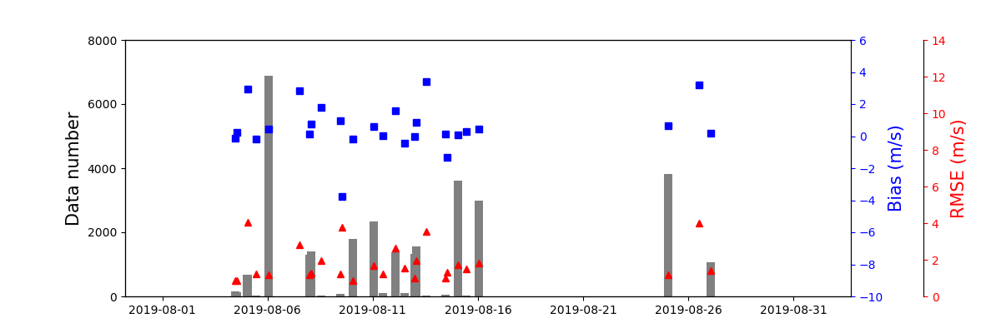
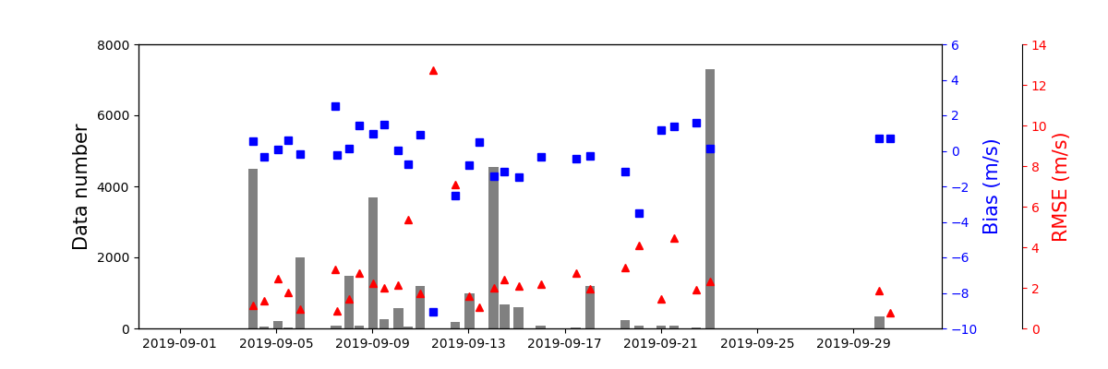
Verification of results
Verification results for typhon cases in 2019
Francisco
Krosa
Francisco
Bias: 0.44, RMSE: 1.59
Lekima
Lekima
Bias: 0.46, RMSE: 2.08
Krosa
Bias: 0.54, RMSE: 2.00
Lingling
Bias: 0.36, RMSE: 1.19
Lingring
Tapah
Tapah
Bias: -1.43, RMSE: 4.70
In summary for typhoons affecting to the Korean peninsula,
Bias: -1.43~0.54
RMSE: 1.19~4.70

Slide 11
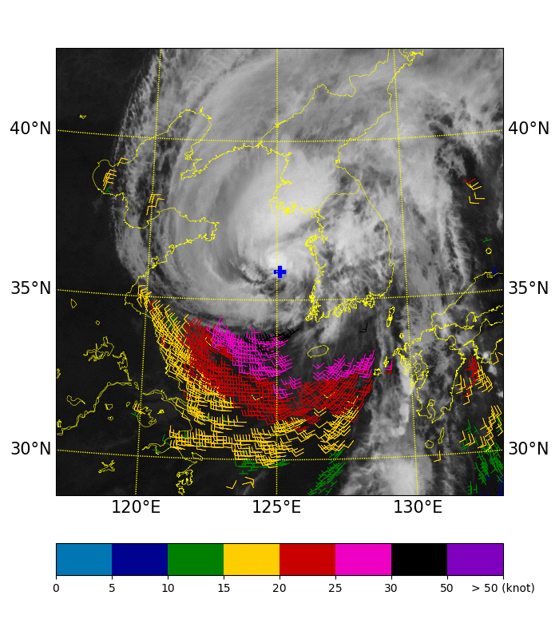
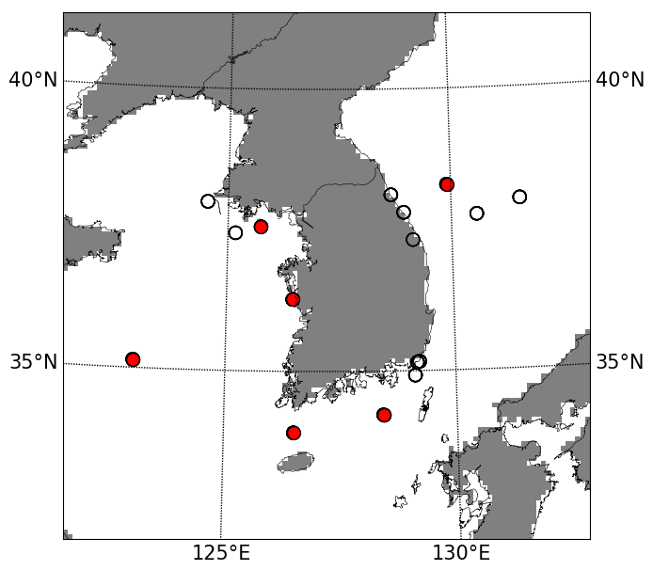
Results: case study
Lingling (2019)
GK2A SSW
2019.09.07. 00:00 ~ 07:00 UTC
Typhoon “Lingling” moved northward with difficulty in predicting the typohoon moving course, and there was warning information about many damages of the Korean peninsula due to extremly strong winds
No observations of microwave low earth orbit(LEO) satellites passing over the typhoon radius after 12:00 UTC on September 6, 2019 when the Korean peninsula was affected in the typhoon's gale radius,
→ Difficulty in acquiring sea surface wind information
Result from comparison with GK2A SSW and BUOY SSW observed at the west and south seas of the Korean peninsula:
Bias= -0.39 m/s,
RMSE=1.82 m/s

Slide 12
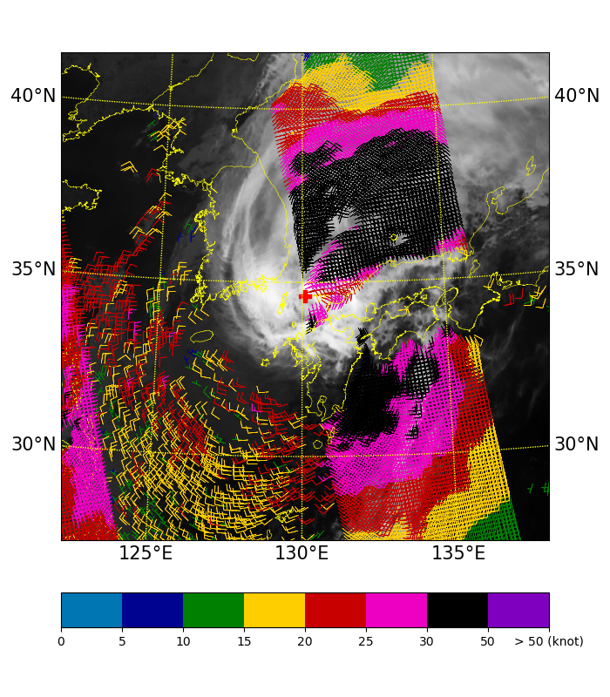
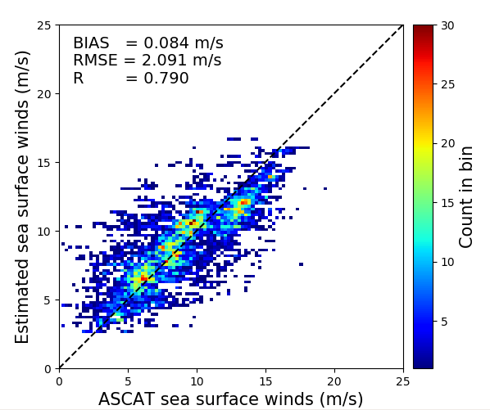
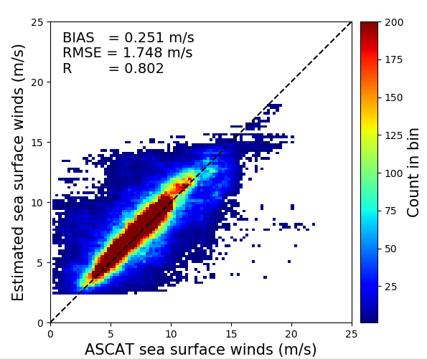
Results: case study
Tapha(2019)
Combination of GK2A and ASCAT SSWs can provide wind information of the lower layer of a typhoon in a wide area
Limitation : Accuracy of GK2A SSW can be decreased at night due to no information of AMV of visible channel
GK2A SSW + ASCAT SSW
2019.09.22. 22 KST (Night time)
SWIR AMV based SSW
(Night time)
VIS AMV based SSW
(Day time)

Slide 13
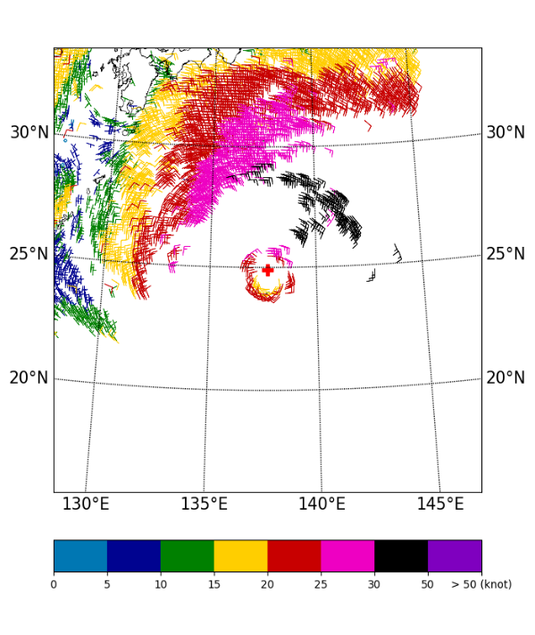
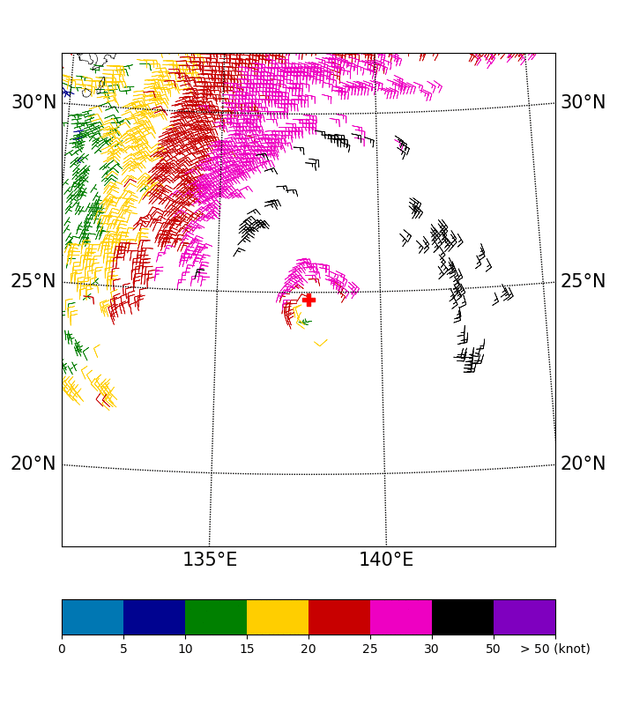
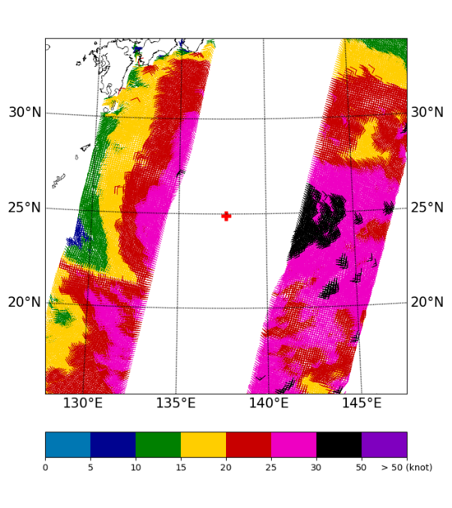
Results: case study
Krosa (2019)
GK2A SSW
GK2A + ASCAT SSW
2019.08.11. 23:00 ~ 08.12. 09:00UTC
METOP-B/ASCAT SSW

Slide 14
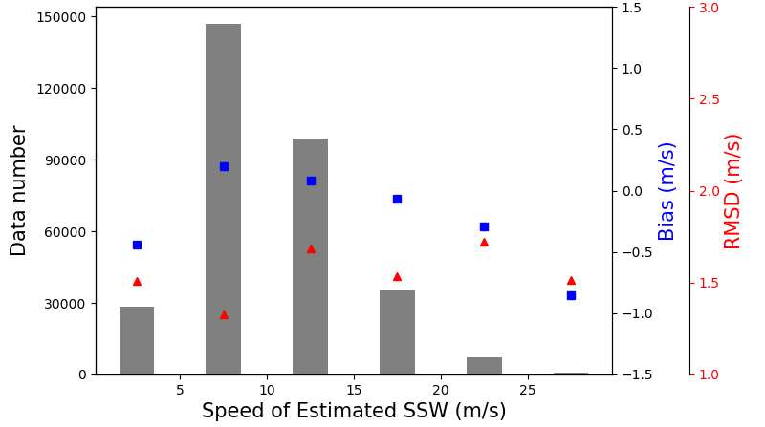
Validation of GK2A ASWind accuracy
2022 Verification
Years | Typhoon name | Formed | Dissipated | Maximum wind speed around center(m/s) | Landfall
2022 | AERE | 7. 1. 09KST | 7. 5. 03KST | 20 | X
 | SONGDA | 7. 28. 21KST | 8. 1. 03KST | 20 | X
 | TRASES | 7. 31. 12KST | 8. 1. 09KST | 18 | X
 | HINNAMNOR | 8. 28. 21KST | 9. 6. 21KST | 55 | O
 | NANMADOL | 9. 14. 03KST | 9. 20. 09KST | 55 | X
Speed (m/s) | N | GK-2A Low-level AMV |  | GK-2A ASWind |  | JMA method ASWind
 |  | Bias | RMSD | Bias | RMSD | Bias | RMSD
0 – 5 | 28249 | -0.50 | 1.54 | -0.44 | 1.51 | -1.48 | 2.06
5 – 10 | 146743 | 0.79 | 1.61 | 0.20 | 1.33 | -0.98 | 1.64
10 – 15 | 98683 | 2.43 | 3.00 | 0.09 | 1.69 | -0.54 | 1.78
15 – 20 | 35282 | 4.45 | 4.76 | -0.06 | 1.53 | 0.41 | 1.63
20 – 25 | 7325 | 7.11 | 7.34 | -0.29 | 1.72 | 1.88 | 2.56
25 – 30 | 739 | 9.27 | 9.38 | -0.86 | 1.51 | 3.04 | 3.32

Slide 15
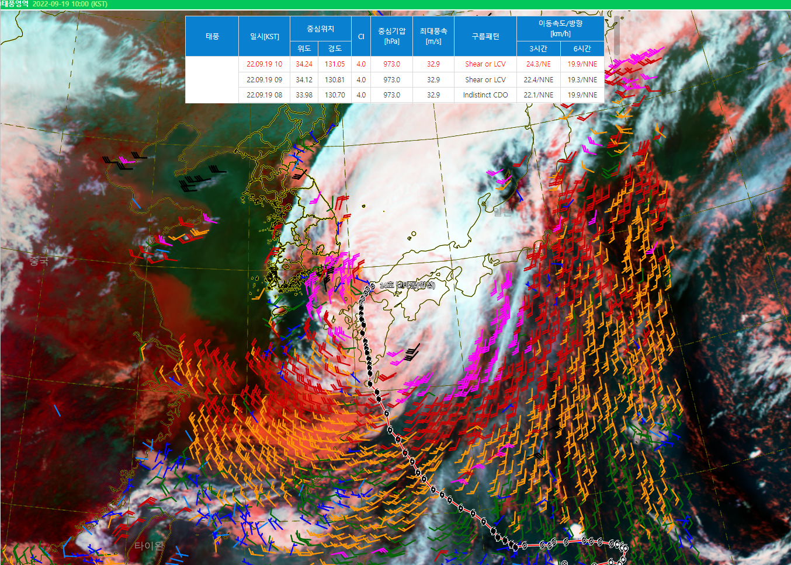
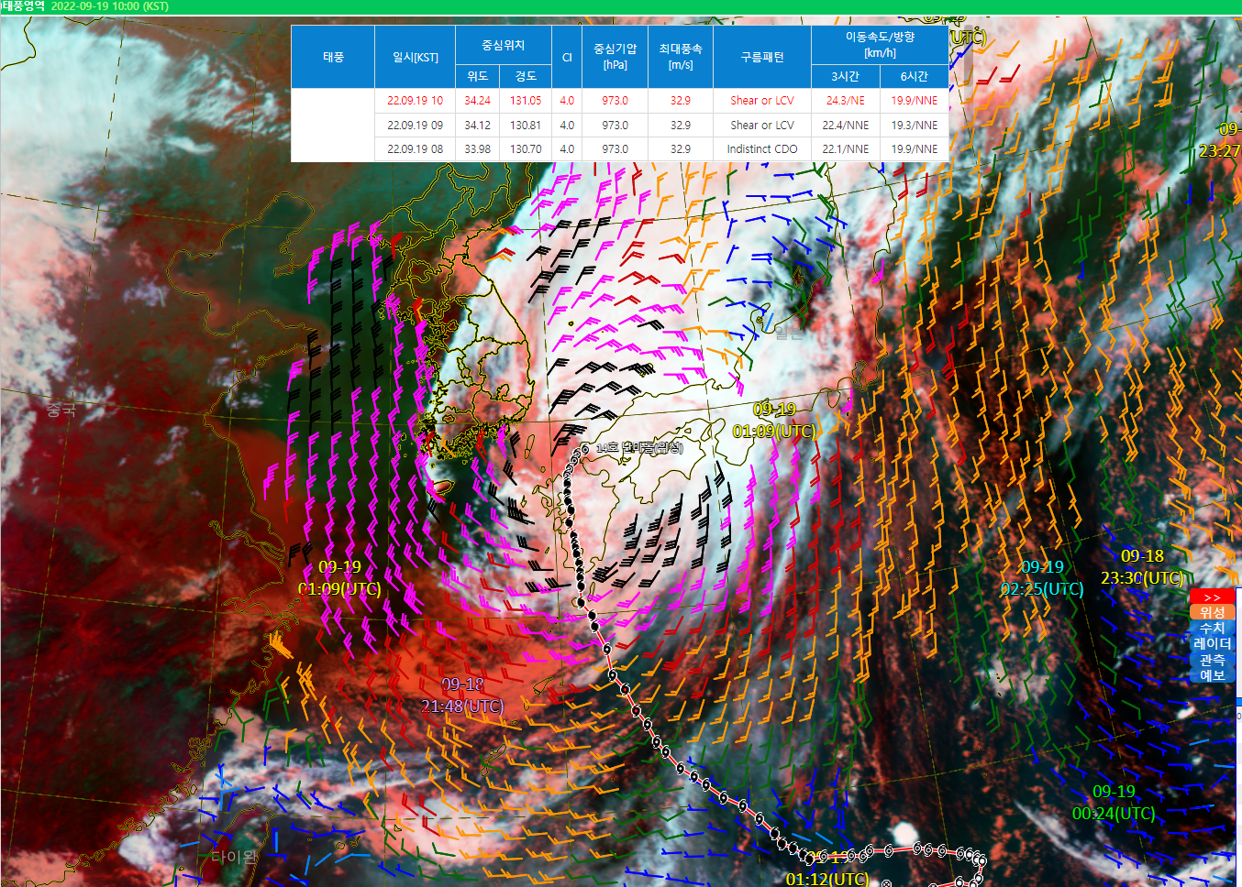
Results: case study
Nanmadol(2022)
MetOp/ASCAT SSW
GK2A SSW

Slide 16
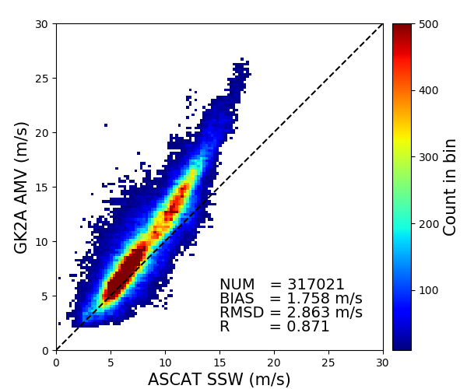
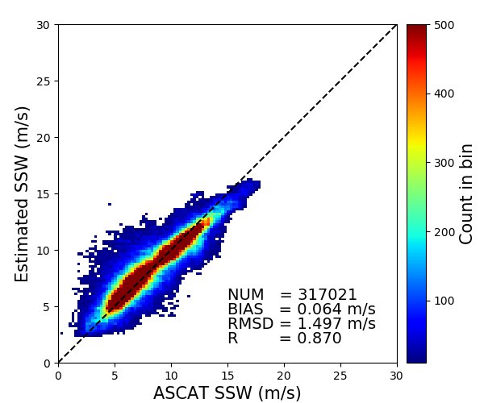
Validation of GK2A ASWind accuracy
AMV → ASWind
Regression

Slide 17
Conclusion and summary
This study aimed to develop a technique for estimating sea surface wind(SSW) information using atmospheric motion vector(AMV) data from the Geo-Kompsat-2A (GK2A), which has high temporal(30 min) and spatial resolution(16x16km).
For quantitative verification between GK2A SSW and ASCAT (or BUOY) SSW
- For GK2A vs ASCAT, Bias = -0.20 m/s, RMSE = 1.77 m/s
- For GK2A vs BUOY, Bias = -0.39 m/s, RMSE = 1.89 m/s
- Reducting wind speed difference between GK2A SSW and ASCAT SSW over 15 m/s
For qualitative Verification
- GK2A SSW can provide information of the low-level wind of a typhoon in a wide area if GK2A SSW data combines to ASCAT SSW
- In case of a typhoon separated from the upper and lower levels,
GK2A SSW can help to analyze the typhoon and its center.
Some limitations
- Since GK2A AMV is calculated by tracking the movement of the cloud top, it is impossible to obtain
lower layer vector data in areas if clouds are thick or upper layer clouds exist.
- Accuracy and density of data can be decreased at night due to no information of
AMV of visible channel.

Slide 18
references
Nonaka , K., K. Shimoji , and Y. Igarashi, 2019: Utilization of Estimated Sea Surface Wind Data Based on Himawari-8/9 Low-level AMVs for Tropical Cyclone Analysis
Nonaka , K., K. Shimoji , and K. Kato, 2016: Estimation of The Sea Surface Wind in The Vicinity of Typhoon using Himawari-8 Low-Level AMVs . Proc. of 13th International Winds Workshop.
Franklin, JL, ML Black, and K. Valde, 2003: GPS Dropsonde Wind Profiles in Hurricanes and Their Operational Implications. Wea. Forecasting, 18, 32-43.
Holmlund, K., 1998: The utilization of statistical properties of satellite-derived atmospheric motion vectors to derive quality indicators. Wea. Forecasting, 13, 1093-1104 .

Slide 19
Thank you for your attention!

